Slide 1
FSM Example
Ruba Alkhasawneh

Slide 2
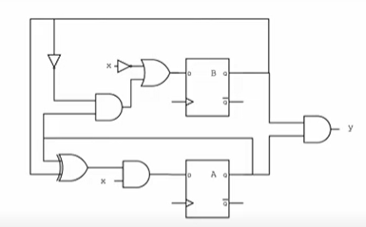
FSM Example
A_{(n+1)} = (A_{(n)} XOR B_{(n)}) . x
B_{(n+1)} = (A_{(n)}.B’ _{(n)}) + x’
Y = A.B

Slide 3












FSM Example
Present State |  | Input | Next State | Next State | Output
A | B | X | A | B | Y
0 | 0 | 0 | 0 | 1 | 0
0 | 0 | 1 | 0 | 0 | 0
0 | 1 | 0 | 0 | 1 | 0
0 | 1 | 1 | 1 | 0 | 0
1 | 0 | 0 | 0 | 1 | 0
1 | 0 | 1 | 1 | 1 | 0
1 | 1 | 0 | 0 | 1 | 1
1 | 1 | 1 | 0 | 0 | 1
0
S0/
S1/
S3/
S2/

Slide 4
FSM Example
Present State |  | Input | Next State | Next State | Output
A | B | X | A | B | Y
0 | 0 | 0 | 0 | 1 | 0
0 | 0 | 1 | 0 | 0 | 0
0 | 1 | 0 | 0 | 1 | 0
0 | 1 | 1 | 1 | 0 | 0
1 | 0 | 0 | 0 | 1 | 0
1 | 0 | 1 | 1 | 1 | 0
1 | 1 | 0 | 0 | 1 | 1
1 | 1 | 1 | 0 | 0 | 1

